Slide 1
Two Complementary EVM Cost-Risk Models
1. Use of EVM Trends to Forecast Cost Risks
2. Integrated Cost-Risk Model (ICRM)
Utilizing ACEIT
For
18 MAR SoCal ICEAA Workshop
David R. Graham
Consultant, Salient Federal Solutions
Carlsbad, CA
dgmogul1@verizon.net
703-489-6048

Slide 2
Use of EVM Trends to Forecast Cost Risks
Some Charts from Original Presentation at
2011 ISPA/SCEA Conference, Albuquerque, NM
Dr. Roy Smoker*
MCR LLC
rsmoker@mcri.com
(Other Charts Added by David R. Graham)
*Roy E. Smoker (2011): Use of Earned Value Management Trends to Forecast Cost
Risks, Journal of Cost Analysis and Parametrics, 4:1, 31-51

Slide 3
Main Points of Paper
EVM data is taken from the PMB’s S-curve at it’s most linear section
  The early part of the PMB’s S-curve represents start up so is not linear
  The ending part of the PMB’s S-curve represents contract ending so is also not linear
  Linear regression equations work best when data is linear
Regression equation developed to forecast BAC
  Unique from most regression equations used in EVM performance projections
  Basis: BAC grows due to learning more about the nature of the work as the effort proceeds and additional work is put on contract through ECOs
Ending month of contract can also be forecasted using regression equations
  Basis: At end of contract BCWP must equal BAC
  Regression equations for BCWP and BAC are set equal to solve for months
    BCWP = BAC ➔ $86.35M*Months = $4,970.56 + $31.76M * Months
    Then just solve for months = 91.06
      NOTE: Calculation made at month 42 - Coefficients change depending on month selected due to amount of available EVM data increasing over time
  Preferred over usual BAC/Avg BCWP or Lipke’s Earned Schedule

Slide 4
Main Points of Paper (cont)
Regression equation developed to forecast percent complete (PC)
  PC = 0 + 0.013772546*Month (“0” is the intercept, that is, at 0 time there is 0 percent complete)
  At month 42, “0.013772546” is the rate of PC/month so, at that rate the completion month is: Completion Month = 100% Complete/1.3772546 %= 72.6 months
    The PC was measured as the raw value of each monthly BCWP divided by the value of the BAC for month 42
  NOTE: Percent complete (PC) using this method understates completion months due to not taking into account rate at which BAC is growing
Variance at Completion (VAC) is a quantification of value of risk that must be burned down
  Regression equation developed to forecast EAC
  Subtract forecasted EAC from forecasted BAC = forecasted VAC
  True significance of forecasted VAC:
    Some risk issues that are part of VAC are known and should be described on Format 5
    Unexpected risks have not yet been discovered but are part of this forecasted VAC

Slide 5
18 Months of Data
Equations:
Regressions run in Excel.
All Cost are $M
Note: Even with the significance in the parameters in these equations there is a good degree of variability as indicated by their standard errors in parenthesis.

Slide 6
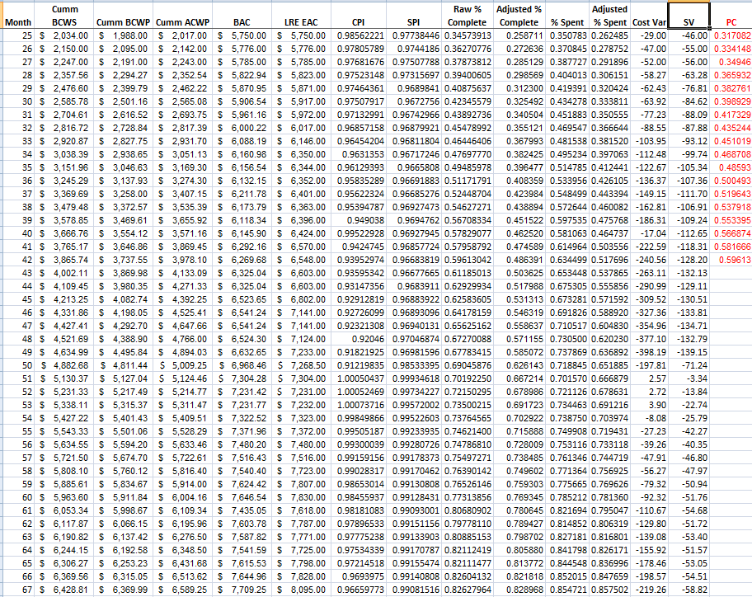
Full 43 Months of EVM Data (months 25 through 67)
(from the Excel based EVM Trend Tool)

Slide 7
Essentially Linear Data
Question: What do you get when you remove the initial start up months and the contract closeout months from the usual S-curve?
Answer: A data set that exhibits the graphic forms shown here. Note, there is a hint of an S-curve without the usual tails.
Research: Can we predict the performance of a long term contract from only 18 months of data covering months 25 thru 42 using linear assumptions?
Answer: Perhaps apply the approach to other, completed programs to validate the results presented in Dr. Smoker’s paper.
We know:
Monthly BAC but not the final BAC
Monthly EAC but not the final EAC
Monthly VAC but not the final VAC
We don’t know the month of the final VAC

Slide 8
BAC & EAC as a Function of Time
The uncertainty in the BAC, based on program office decisions to remove work and add work to the contract, also creates uncertainty in the EAC as shown here
However, both equations based on 18 monthly observations are significant and can be used to predict the growth of both BAC and EAC thru time
With EAC growing faster than BAC, the question is when will this contract reach completion so that VAC stops growing?

Slide 9
VAC as a Measure of Risk
Risk is measured in EVM terms as any deviation from the original baseline.
  That is, risk is anything that results in a variance
Therefore, VAC is the basic measure of risk encountered by the end of the contract effort
  Whether the risk is rooted in opportunity with a positive variance
  Or, is rooted in issues related to planning of scope, estimating, scheduling, or technical criteria that are identified during testing and generally associated with a negative variance

Slide 10
Risk Burn down (1 of 2)
The final VAC may be estimated as the difference between the linear forecast of BAC and EAC
Risk burn down may be measured as the amount of VAC that has been worked off
Therefore, it is possible to show the %risk burn down as a function of the amount of cumulative VAC that has been incurred relative to the final VAC

Slide 11
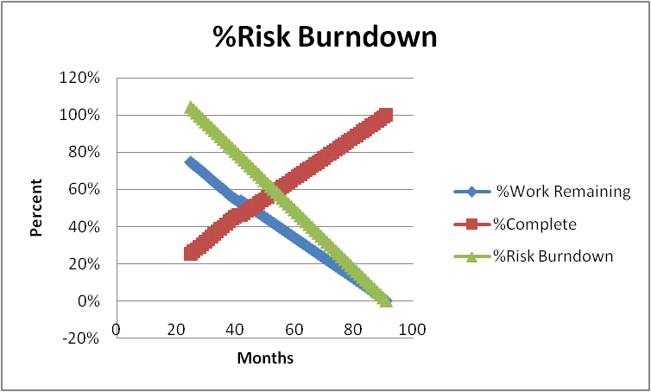
Risk Burn down (2 of 2)
Here the green line represents the %Risk that has been burned down and measured as:
1 - Cum VAC/Final VAC
It is interesting to note that early in this program, risk is being burned down faster than the remaining work is being accomplished.
Finally, Risk is burned down to zero as remaining work is reduced to zero and percent complete approaches 100%

Slide 12
Summary – Contract Scope
We have learned
  An S-curve with its tails removed exhibits significant linearity with variability
  The scope of a contract grows across time
  New work pushes out the expected completion date
  There is a future date where
    BCWP will equal BAC
    From this equivalency the expected completion date can be calculated
  Each monthly %complete drops as BAC grows

Slide 13
Summary – Trend Analysis
We have learned
  Normal monthly EACs fall short of final EAC
    Due to same contract scope growth that affects BAC
  Trend analysis
    Helps identify the completion date
      Can then estimate the final EAC
      Can then estimate the final BAC
  Final VAC
    Can be estimated as: (Final BAC – Final EAC)
    VAC appears useful in measuring the value of a program’s risks (planning, estimating, scheduling, technical)
    May be used to measure how risks get burned down across the period of performance from ATP to Estimate Completion Date

Slide 14


Slide 15
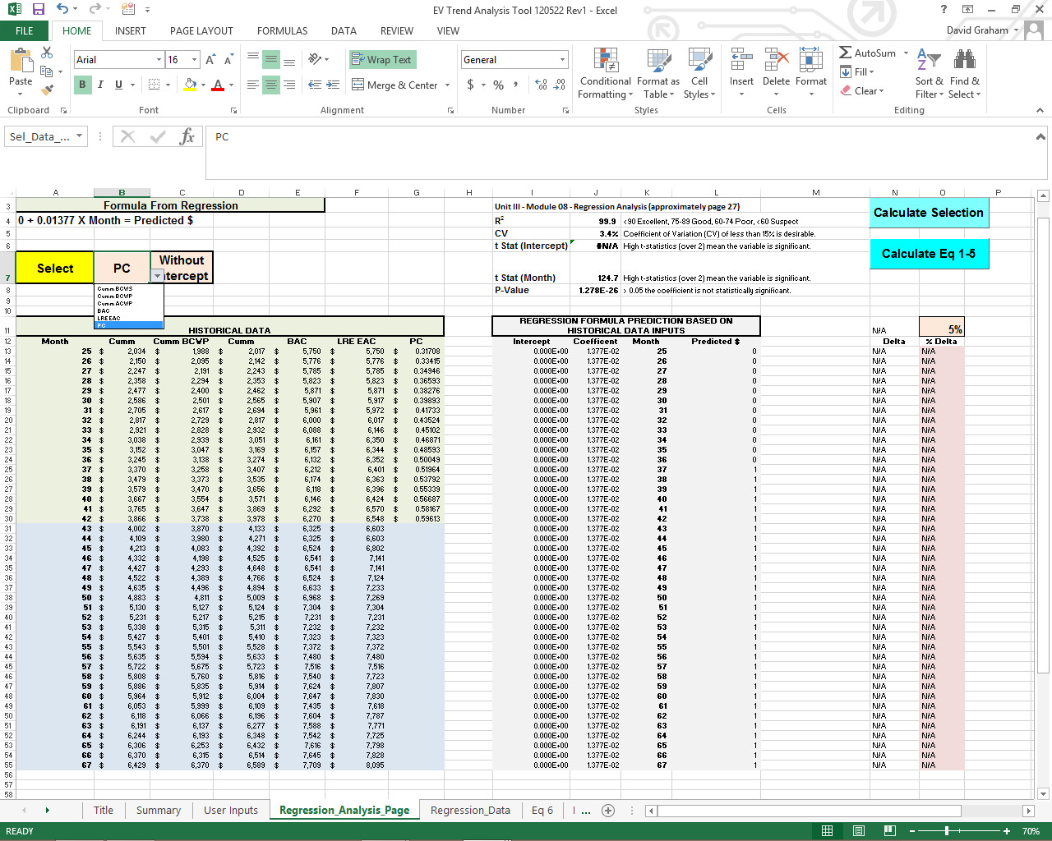

Slide 16
Integrated Cost-Risk Model (ICRM)
Utilizing ACEIT
David R. Graham
Consultant, Salient Federal Solutions
Carlsbad, CA
dgmogul1@verizon.net
703-489-6048
NOTE: Special thanks to Darren Elliott of Tecolote, Inc., for actual ICRM programming

Slide 17
Outline
What ICRM Brings
ICRM Model Overview Narrative
ICRM Model Structure Illustration
Note on Simulation Assumptions Used in the ICRM Model
5X5 Risk Matrix Rating Scales
Dominant Likelihood Algorithm
DAU EVM 201 LAR Risk Register
ICRM Mechanics General Overview
ICRM WBS Element and Risk Prioritization Tornado Charts & PDF/CDF Graphs
ACEIT Workscreen Examples
ICRM Customization
Summary

Slide 18
What ICRM Brings
EVM data and risk register results into a probabilistic context using the DAU Light Assault Reconnaissance (LAR) Vehicle case study as the database for illustrating the ICRM
True confidence levels of contractor WBS-level EACs
  Through applying a range of WBS-level EVM PFs to create a distribution of possible ‘adjusted’ BCWR values at the WBS element level (cum ACWP + adjusted BCWR = EAC)
  Allowing identification of where contractor WBS-level EACs fall in the distributions
WBS-level Risk Register-driven cost-risk distributions
  Identifies risk register risks to affected WBS elements
  Applies risk likelihoods and cost consequence ranges to WBS element BCWR values
Integration of both WBS PF-based and WBS Risk Register-based distributions by statistically summing them through monte carlo simulations in ACEIT producing an overall EAC cost-risk distribution

Slide 19
What ICRM Brings (cont)
Enables prioritization
  By WBS elements most cost-impacted by risks, and
  By risks causing the most significant cost impacts
These results provide the basis for an ongoing meaningful dialogue that is not happening today between the EVM analysts, technical risk management teams, cost estimators, schedule analysts, project officers and, ultimately, the program managers based on cost impacts caused by risks

Slide 20
ICRM Model Overview Narrative
Enter in EVM data (e.g., BCWS, BCWP, ACWP cum-to-date)
Non-Probabilistic EAC calculation
  Derive BCWR (BAC-BCWP); adjust by performance factor; develop EAC (i.e., ACWP cum-to-date + adjusted BCWR)
  NOTE: Can use BAC assuming growth derived from EVM Trends Approach
Performance Factors range data
  Use CPI; SPI; CPI*SPI; (can use other PFs) as separate cases or two at a time in a Min & Max uniform distribution
  Utilize ACEIT’s capability to identify minimum/maximum results to construct a PF-based range distribution relaxing the analyst’s workload
  Risk Register data
  Identify risks and their impacts to specific WBS elements
    One risk to one WBS; one risk to many WBSs; many risks to one WBS
  Use midpoint of risk likelihoods (e.g., if range=5%-20%, use 12.5%)
  Identify risk cost consequence ranges (i.e., low, most likely & high values) and apply resulting percent impacts on adjusted BCWRs
Incorporate all risks in Latin Hypercube ACEIT simulations and calculate EAC as a total value that includes all risk effects
Notes:
Does the risk register data and performance factors risk data happen independently and simultaneously during the simulations? Yes

Slide 21
ICRM Model Structure Illustration
Statistical PF Range & Risk Register-Impacted EAC
Risk Register Risk Inputs (ID WBSs impacted; Cost Consequences; Likelihoods)
Performance Factor Range Impact Calculation (Range * affected WBS items)
EAC Calculations Based on Single Performance Factor (PF)
Notes:
What’s the linear sequence of the boxes?

Slide 22
Note on ICRM Simulation Assumptions
Decision Rule on Whether the Risk Actually Happens
  Random number generator produces a number between “0” & “1” that compares against the risk register’s likelihood
    The “Dominant Likelihood” algorithm determines the ‘winner’ of the comparison and either includes the full risk’s cost consequence or none of the consequence

Slide 23
5x5 Risk Matrix Rating Scales
Definitions From Program’s Risk Management IPT
Level Likelihood of Occurrence
  1 Not Likely (5% - 20%)
  2 Low Likelihood (21% - 40%)
  3 Likely (41% - 60%)
  4 Highly likely (61% - 80%)
  5 Near certainty (81% - 99%)
NOTES ON COST CONSEQUENCE APPROACHES
Alternative 1: Percent of last approved cost estimate
Alternative 2: Percent of affected WBS element’s BCWR (i.e., S/C, P/L, etc.)
Alternative 3: Percent additional resources taken as a function of burn rate per schedule slip on WBS element(s) affected
Consequence
(Note: Percentages from DoD range guidance)
Cost Consequence Rating (see notes, Alternatives 1,2 &3)
  5 Critical (23% - 28%)
  4 Serious (15%- 20%)
  3 Moderate (10% - 15%)
  2 Minor (5% - 10%)
  1 Negligible (1% - 5%)
  OPP (opportunities) Potential cost savings (added to matrix)
(Note: Percentages from DoD range guidance)
NOTE: Number of risks in above example are from DAU EVM 201 LAR Risk Assessment

Slide 24
Dominant Likelihood Algorithm
General Process Overview
1). Identify Discrete Risks
Risk #1
Risk #2
Risk #3
…
NOTE: Random # Draw = > 0 and < 1
Σ
Max. # Risks
Likelihood
> Random
# Draw
2). Estimate Consequence
WBS, Months delay, Phase
of Delay
WBS % Increase in NRE, REC
or both
Convert both to $
Yes
No
N = 1
}
Don’t add
consequence
Add full
consequence
3). Estimate Likelihood
Remote, Unlikely, Likely,
Very Likely, Near
Certainty
Run appropriate
# of iterations
Develop Cumulative Distribution

Slide 25
DAU EVM 201 LAR Risk Assessment
High:
1. Engine
2. Cooling
3. Exhaust
4. Suspension/Steering
5. Power Pac/Sub Sys Design
Medium
6. Fuel System
7. Controls/Instrument
8. Subsystem Test
9. Armament
10. Integration/Assembly
Low
11. Frame
12. Aux Automotive
13. Body Cab
14. Communications
15. Sys Engineering & PM
16. Sys Test & Evaluation
17. Training
18. Data
19. Peculiar Supt Equipment
.
.
.
.
1, 3
5
4
3
2
1
NOTE: Based on the risks
(risks not defined),
these WBS elements
were prioritized by
the technical experts
as having the highest
cost impacts.
.
9
4, 5
2
.
4,5
15
8
6, 7
.
.
LIKELIHOOD
.
14
11, 12
13, 16
10
.
17, 18
.
19
.
.
1 2 3 4 5
CONSEQUENCE
As of Dec 2003
Notes:
This chart introduces a standard risk matrix. It is consistent with the Ms Goodwrench briefing.

Slide 26
Mechanics
General Overview
A basic assumption in using this ACEIT-based ICRM model is that program EVM analysts are not expected to be proficient ACEIT users but can work with their cost estimator counterparts who are proficient
The ACEIT v7.3a ICRM capability is enabled with the new “Probability of Occurrence” column
  This enables the ‘likelihood’ part of the risk register to be a direct input into ACEIT and function in its Latin Hypercube monte carlo simulations IAW the Dominant Likelihood algorithm
This particular ICRM model incorporates this new ACEIT capability plus custom ACEIT Dynamic Equation Columns (DECs)
  These DECs enable EVM metrics and index information to be used in calculating an EAC range that is probabilistically derived
  These DECs also provide new variables and functions used in ICRM calculations

Slide 27
Mechanics
General Overview (cont)
The ICRM ACEIT model’s Workscreens enable analysis functions
  These analysis functions exist in the interplay between the Equation/Throughput columns, DECs and within the INPUT VARIABLES sections of each of the Workscreens
  These analysis functions enable the essential calculations for the probabilistic EAC to be produced
    Calculations incorporate both EVM best and worst case EVM Index-derived EACs and risk register likelihoods and cost consequences

Slide 28
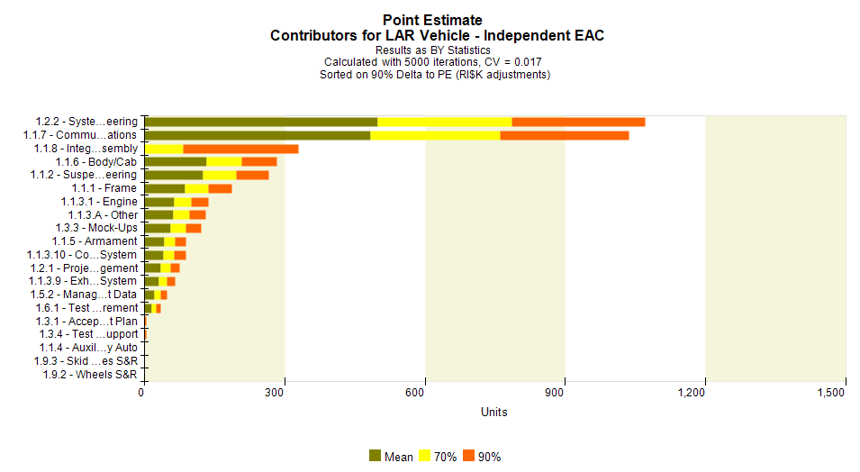
Cost Impact Prioritization by WBS

Slide 29
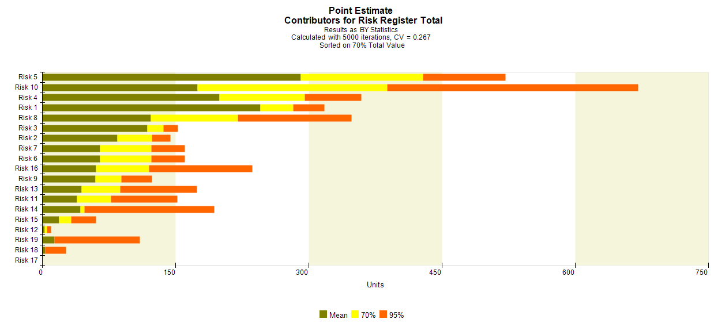
Quantitative Ranking – 70% Tail

Slide 30
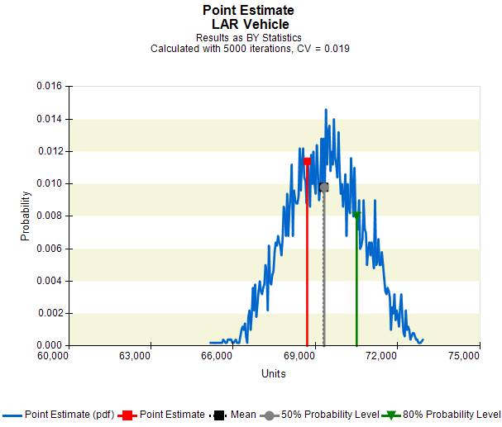
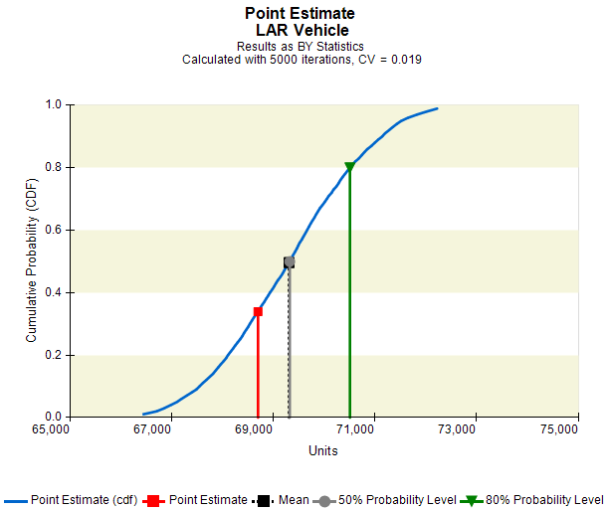

Slide 31
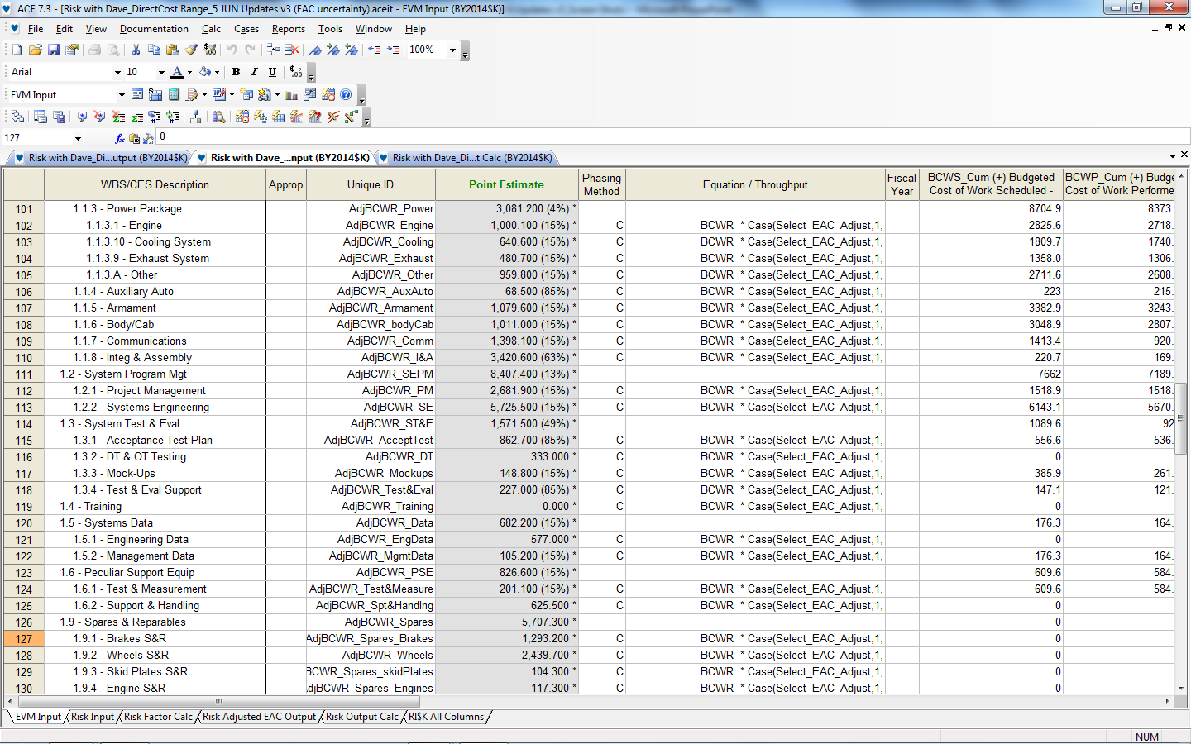
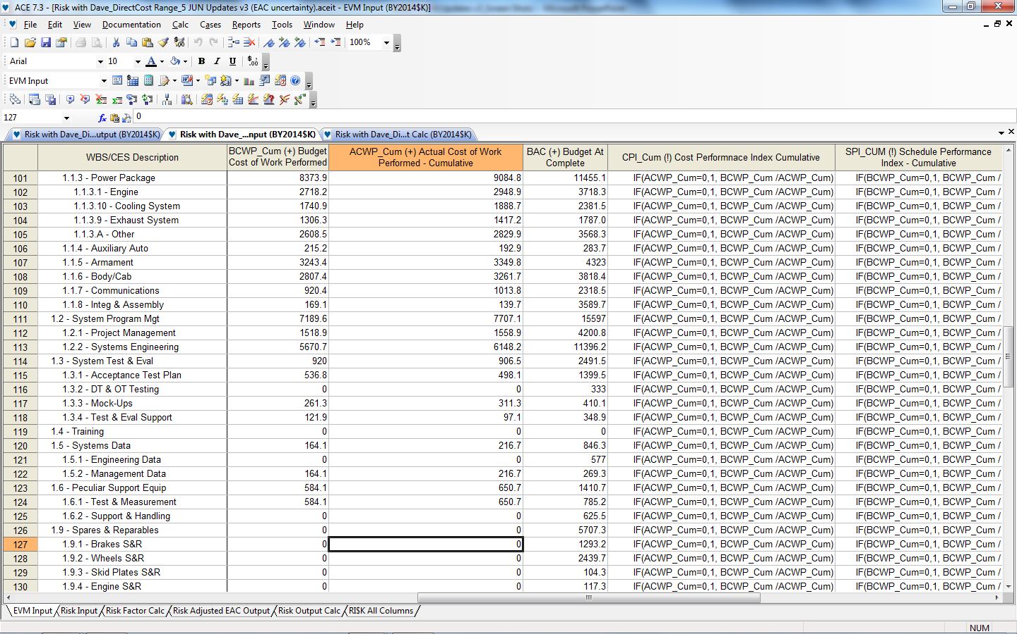

Slide 33
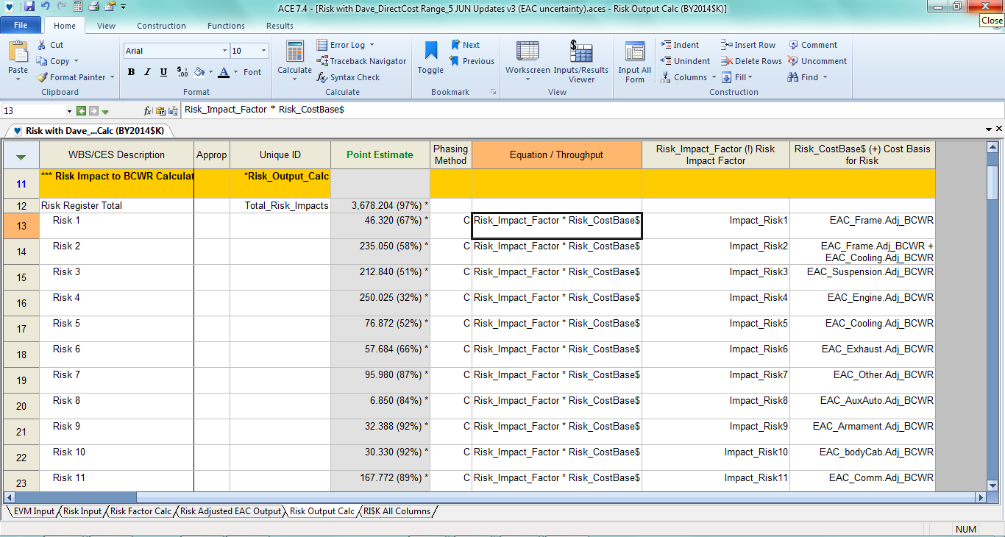

Slide 34
ICRM Customization
Future versions of ICRM can be easily customized
  Add or subtract Workscreens to make it more efficient
  Different distributions can be specified for risk register impacts
  Different EVM performance factors can be applied
  EVM analysis can be applied to risk register cost consequences
  Cost estimator analysis can be applied to risk register cost consequences

