Slide 1
Estimation and Measurement with
User Stories/Story Points* for ICEAA
*Excerpts from Galorath Story Point Training Course
Bob Hunt – President Galorath Federal
David DeWitt – Galorath Incorporated

Slide 2

The Emergence Of Agile
In the late 1990’s several methodologies began to get increasing public attention.
They all emphasized
  close collaboration between the
  programmer and business experts
  face-to-face communication
  (as more efficient than written
  documentation)
  frequent delivery of new deployable business value- tight, self-organizing teams
  and ways to craft the code and the team such that the inevitable requirements churn was not a crisis
While Story Points were around before Agile, it is the use of Agile Development that brings them into vogue today

Slide 3
A Word About Size Metrics
Very few software development projects start without some concept/metric of how long and how much time the development will take
The Estimator's challenge is to "quiz" that out of the metric
I have always felt more confident in my answer when the estimation team's size metric/proxy and the development team's effort proxy were the same
I believe there is more estimation error from poor sizing than from estimation models or processes
The fact that this is a briefing about User Stories/Story Points in no way a critique of Lines of Code or Function Points or any other size metric

Slide 4
User Story Defined
A User Story is a simple statement about what a user wants to do with a feature and the value the user will gain.
Consider a User Story as a thin vertical slice through the system.
User stories are written from the user perspective in a way that can be easily understood.
  Technical jargon is avoided.
Acceptance Criteria is usually written at the same time.
The Project Owner is responsible for the user stories
  Written by the Sponsor
  Reviewed by the project team
Usually written on cards
  Story on the front
  Acceptance Criteria on the back

Slide 5
Anatomy of a User Story
A User Story identifies:
  The User
  What the user wants to do with a feature
  Value gained by the user
So a User Story can use the following format:
As a (user role)
I want (feature/achieve something)
So that (describe value)
As a customer I want to track my order from the time I place it until it is delivered so that I know the status of my order at all times.

Slide 6
Writing User Stories On An Agile Project
User Stories are owned by the Product Owner
  Written by the Product Owner or a surrogate of the Product Owner such as a Business Analyst.
  The product owner ultimately approves the User Story.
User Stories are written from feature lists with the intention of filling the product backlog.
  This is often done in iteration zero
Before placing a User Story in the backlog, the story is reviewed, acceptance criteria is written, and the story is pointed.
The Team, with the help of the Product Owner, selects User Stories from the project backlog for an iteration.
  This is part of iteration planning.

Slide 7
User Stories And Other Requirements
As mentioned previously, User Stories are requirements, but sometime more information is needed.
Since you want to keep User Stories light and negotiable, you may have to supplement them with information as the story progresses.
Other types of requirements include:
  Business rules
  Regulations
  More detail
Consider referencing these requirements on the bottom of the User Story card.

Slide 8
Bad User Story
As an AR Clerk I can add invoices to the system
What’s wrong:
  No value shown. The value may imply other things we will want to do with an invoice.
Better:
  As an AR Clerk I want to add invoices in the system so that I can easily view the invoice when needed.
  This implies that that we must be able to view invoices in the AR system.

Slide 9
Story Points
A "User Story" is a simple statement about what a user wants to do with a feature and the value the user will gain from that feature.
A "Story Point" is a methodology to assess the relative weight/effort level of a User Story
NOTE 1 - Some would say that User Stories and Story Points are project and developer unique and therefore NOT transferable to other projects. And, there is some truth to that statement.
NOTE 2 – The modern "cynic" might say the same thing for SLOC and Function Points
At this time there is little standardization associated with User Stories or Story Points so be careful when drawing inferences beyond a specific program.

Slide 10


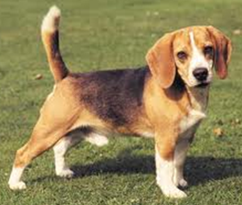
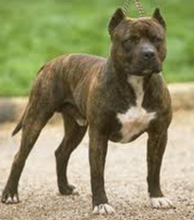



Rate The Following From 1 - 10
Simply give each dog a value between 1 and 10. 1 is least and 10 is most. Numbers can be repeated
Don’t over think the question

Slide 11
Try The Exercise Again Using One Of The Following Assumptions
How long will it take to Groom the dog?
How fast can it run?
How much does it weigh?

Slide 12
Story Points Defined
Story Points represent a value given to a user story that is used to measure the effort required to implement the story.
  Points are assigned to User Stories
  Those point values are later used to estimate
It is a number that represents story size based on how hard a story is to implement.
When assigning points to a story focus is placed on effort to implement but not on time. That comes later during estimation.
Many would say that a story point is an arbitrary measurement that depends on the team.
  There is some truth to that statement
  We can manage that to some extent

Slide 13
Most Likely… The Answer Changed
The exercise that was just performed is exactly how story points work
  Note: We are leaving puppies behind and will consider the item to size is a “User Story”
When sizing User Stories with Story Points one must consider many things. For example:
  How complex is the User Story (number of skills that may be needed)
  How much functionality already exists (and does not need to be design/coded/tested)
  How does it compare to similar User Stories (scale)
  Is it too big a story to properly try to size
The goal is to understand how much “Effort” is required

Slide 14
How Much Effort Is Required?
Look at other things surrounding the implementation of the story. Especially architectural maturity
One story may look complex but all the infrastructure is already in place or understood
Another may require creating a whole new piece of the architecture where there is a lot that is not understood
Of course not understanding is fine because we prototype. But it still can be included in how hard a story may be

Slide 15
Things To Consider When Counting SPs
Number of interfaces with the outside world
  Most agile teams do not function in a vacuum and must consider the needs of the rest of the organization.
  Certain tasks and artifacts may be required by the organization or by governance that the team will have to support.
  This could vary depending on the story or the product.
Complexity of the Code
Number of required tasks
  Depending on the story certain formal or informal tasks may not be necessary.
  Regulation can play into this
    There may be more checks and balances to a story due to governance
Coordinating people takes effort too

Slide 16
Some Drawbacks To Story Points
Story Points are team dependent!
  Members of different teams will have different levels of experience leading to different perspectives related to how hard a story is.
Points don’t easily scale across different projects.
  How one team’s points can vary.
"Inflation" can occur as soon as the second sprint
  Teams often blame not delivering the Story due to a faulty count. That is usually not the reason!
  As a consequence a natural inflation appears during the next count.

Slide 17
Steps In Pointing Stories
Start with a point system that everyone agrees on.
  It is best that the system used to compare against is used across projects just for consistency.
Identify at least one base story.
  It could be a medium or average size story but it doesn’t have to be.
  This base story will be used to compare other stories against.
Review each story as a team.
  Discuss its complexity and size considering what it will take to develop the story.
  Compare the story against the base story and agree on a score for the story selecting a number in the sequence being used.
The team must agree unanimously on a score
  You can use games to determine score.

Slide 18
Choosing A Pointing System
Most pointing sequences are chosen at the organization level and used by all agile projects.
The most common sequence is the Fibonacci Series which is: 1, 2, 3, 5, 8, 13, 21, 34, 55…
Many teams use a version of Fibonacci that looks like: 1, 2, 3, 5, 8, 13, 40, 100 (this is what SEER does)
  The reasoning for using this is that the original sequence suggests accuracy and real projects at a close precision
  This gives the team a clear choice to differentiate for large stories.
    There isn’t much different between 13 and 14 or 15, but there is a different between 13 and 21. We can see the difference.

Slide 19
A Process For Assigning Points
Review a group of stories as a teams
  Discuss the complexity of the story and the activities that will be needed to implement the story.
  Consider unknown technology and new processes required.
  Each team member selects a number from their Planning Poker deck of cards
  The team discusses until they agree on a point value.
  If the team can’t agree, the story is sent back to the Product Owner to be rewritten.
  If a story point cannot be agreed upon the problem usually resides in the story itself.

Slide 20
Exercise: Planning Poker Exercise
Each team member gets a deck of Planning Poker Cards
Assign one team member as the Scrum Master to read the story out loud and negotiate a consensus
Each person selects a card representing the points they want to assign but do not let anyone else see it.
Everyone exposes their card when directed by the Scrum Master
If everyone has the same number the story is assigned the points chosen.
If not, the people with the lowest and highest point value explain reasoning for their point selection.
Re-voting takes place and is repeated until everyone agrees.
The following slide contains four easy User Stories

Slide 21
Story Point Velocity
Velocity measures how much of something can be achieved over a fixed period of time; e.g. how many Story Points are completed during a Sprint
  You could do this at the User Story level but you have no relative measure between User Stories
Velocity is a “team” measurement – not the individual
Iteration Duration / Completed Total SP = Velocity
Iterations needed = Total SP / Velocity
Don’t change the duration and use the same result
Quiz: A project has a total size of 365 Story Points. The team has a velocity of 25/SP per iteration
How many iterations will the project take?
Notes:
365 / 25 = 14 iterations. Be them two week, four week, however long a typical iteration was used to calculate the velocity
21

Slide 22
And Why Should I Care About Velocity?
Velocity Measure provides a way to translate a Size into a duration
  Every estimate starts with a Size estimate (Lines of Code, Function Points, Use Case Points, Ideal Days, Story Points, Hot Dogs in a bucket!)
Size / Velocity = Duration
Every estimation process requires a relationship between a volume measure (Size) and productivity – how much size can be done over time
Velocity can be sued as a TEAM productivity measure.

Slide 23
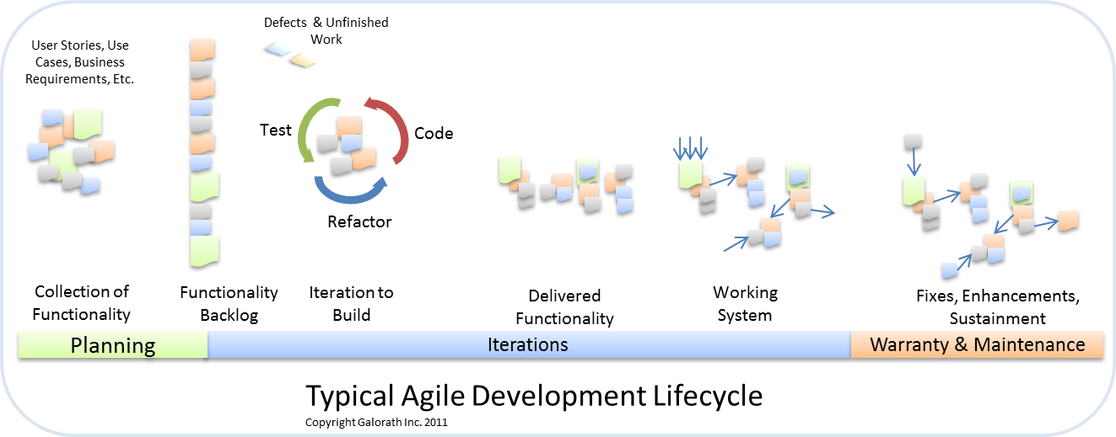
Story Points Velocity Can Be Used to Determine Duration/Iterations
What does the customer want…. A Schedule!
But to provide one you need to know the teams Story Point “velocity”
If the schedule is too long then some functionality could be removed – or other adjustments made
Notes:
Assume previous quiz used 3 week sprints… How many months is the schedule 3 weeks * 14 iterations = 10.5 months
23

Slide 24

Advantages To Story Points (a few)
Prevents Managers from converting a SP into a Calendar day (They have to know the velocity)
Promotes cross-functional behavior (teams can compare similar things)
Points do not decay (when compared to ideal days)
They are a “Pure” size measure relative to other known things
People are pretty good at generating a valid relationship of size

Slide 25
Disadvantages
Difficult to explain
  May resort to comparing Poodles to Great Danes
Teams have different interpretations when working independently
  Story Points need to be scored as a team
Tendency to skip over detailed iteration planning by assuming a velocity * SP = work
  Still need to break the User Story into tasks and estimate the capacity for the sprint
Takes a while to trust the results
  But this is common for all new sizing measures!

Slide 26
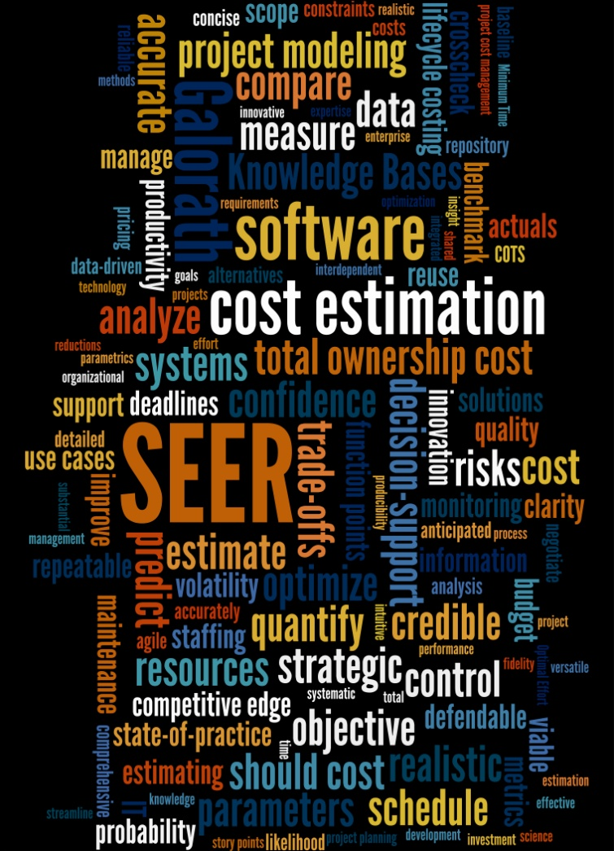
Galorath Contacts
QUESTIONS
Dan Galorath, 310-414-3222 ex 61; Galorath@Galorth.com
Bob Hunt, 703-201-0651; Bhunt@galorath.com
David DeWitt,321-848-3410; Ddewitt@galorath.com

